Slide 1

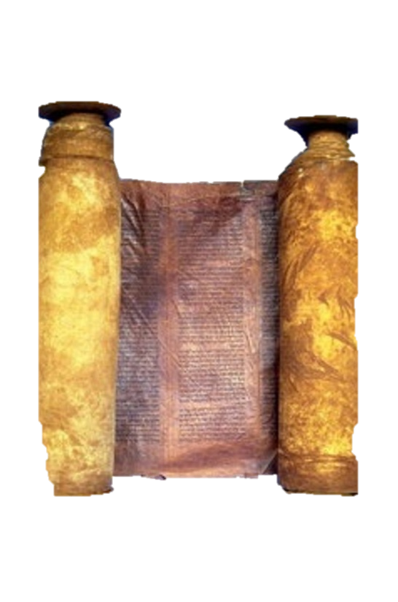




A free CD of this message will be available immediately following the service
2 Kings
8-10
A podcast will also be available later this week at calvaryokc.com

Slide 2



Chuck Smith ~ “When we choose to go our own way, we become entrapped.”
2 kings 8-10

Slide 3
2 kings 8-10

Slide 4
Ahab
Jehoshaphat
Ahaziah
Jehoram
Jehoram
Athaliah
2 kings 8-10

Slide 5
2 kings 8-10

Slide 6
Israel
Judah
Ahaziah, 853-852
Jehoshaphat, 871-847
Jehoram, 852-841
Jehoram, 847-840
c
2 kings 8-10

Slide 7
2 kings 8-10

Slide 8
Only Northern king to be anointed
2 kings 8-10

Slide 9
2 kings 8-10

Slide 10
Ahab
Jehoshaphat
Ahaziah
Jehoram
Jehoram
Athaliah
Ahaziah
2 kings 8-10

Slide 11
2 kings 8-10

Slide 12
1 Kings 21:19b ~ “In the place where dogs licked the blood of Naboth, dogs shall lick your blood, even yours.”
2 kings 8-10

Slide 13
2 kings 8-10

Slide 14
1 Cor. 15:33b ~ "Evil company corrupts good habits."
2 kings 8-10

Slide 15
Israel
Judah
Ahaziah, 853-852
Jehoshaphat, 871-847
Jehoram, 852-841
Jehoram, 847-840
Azariah, 840
c
2 kings 8-10

Slide 16
2 kings 8-10

Slide 17
Literally, put her eyes in painting
2 kings 8-10

Slide 18
2 kings 8-10

Slide 19
1 Kings 21:23 ~ And concerning Jezebel the Lord also spoke, saying, “The dogs shall eat Jezebel by the wall of Jezreel.”
2 kings 8-10

Slide 20
2 kings 8-10

Slide 21
Deceptively ~ oqvah - from same root as Jacob
2 kings 8-10

Slide 22
2 kings 8-10

Slide 23
Refuse dump ~ KJV, draught house - i.e. a public toilet
NIV, NASB, latrine
2 kings 8-10

Slide 24
2 kings 8-10

Slide 25
Israel
Judah
Ahaziah, 853-852
Jehoshaphat, 871-847
Jehoram, 852-841
Jehoram, 847-840
Jehu, 841-814
2 kings 8-10

Slide 26
D. L. Moody ~ “I cannot preach on hell unless I preach with tears.”
2 kings 8-10

Slide 27
2 kings 8-10

Slide 28
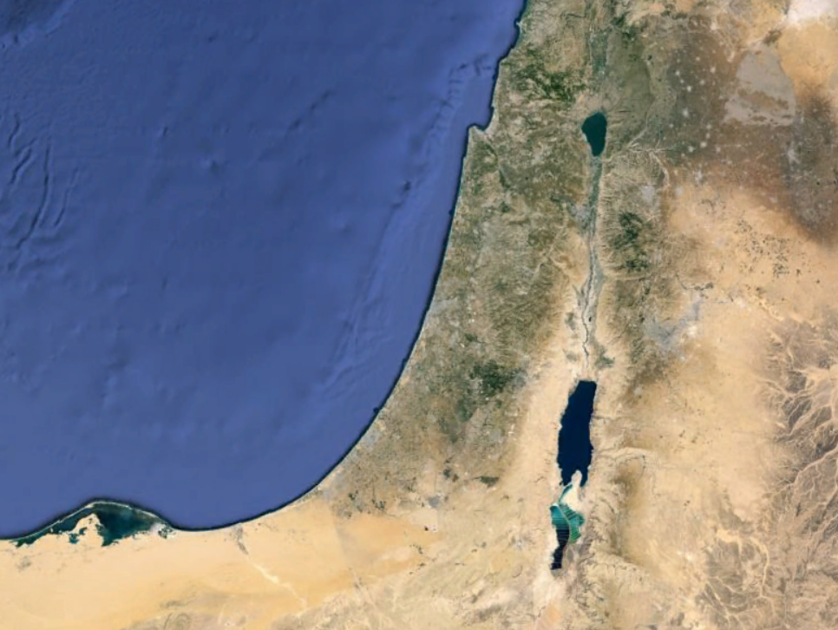
MANASSEH
GAD
REUBEN
2 kings 8-10

Slide 29
2 kings 8-10

Slide 30
Hos. 1:4 ~ … I will avenge the bloodshed of Jezreel on the house of Jehu.
Eze. 33:11 ~ “As I live!” declares the Lord God, “I take no pleasure in the death of the wicked, but rather that the wicked turn from his way and live.”
2 kings 8-10

Slide 31
2 kings 8-10

